Slide 1
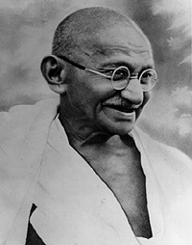
Mahatma Gandhi
Born on 2nd October 1869 in Porbandar, Gujarat
Full name: Mohandas Karamchand Gandhi
Officially honored in India as “Father of the Nation” or “Bapu”
2 October, is commemorated in India as Gandhi Jayanti, a national holiday, and worldwide as the International Day of Non-Violence

Slide 2
Why is Mahatma Gandhi called the “Father of the Nation”?
He brought Freedom to India from British rule in 1947 - Swaraj
He was the pre-eminent political and spiritual leader of India during the Indian independence movement (“Quit India”.
Gandhi employed non-cooperation, non-violence and peaceful resistance as his "weapons" in the struggle against British.

Slide 3
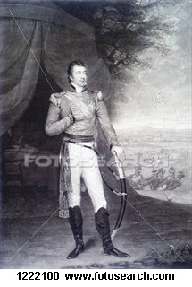
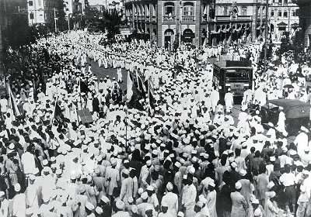
Freedom Struggle of India
British ruled India for about
100 years
People in India protested

Slide 4
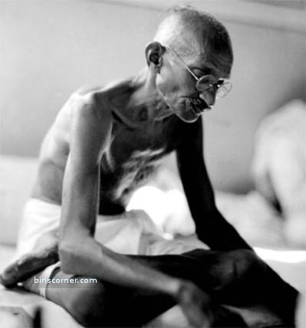
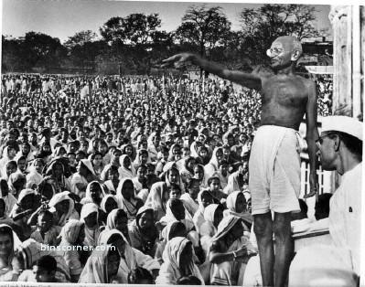
Gandhi Fasting
Mahatma Gandhi became the Leader of the Freedom Struggle
Gandhi Addressing People

Slide 5
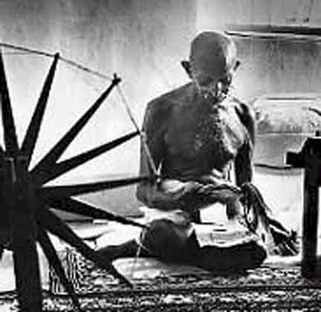
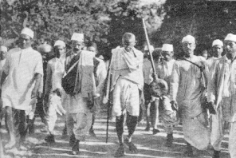
Mahatma Gandhi believed in Non-cooperation, Non-violence (Ahimsa)
Gandhi spinning Khadi (Cotton)
Salt Satyagraha “Dandi March’

Slide 6
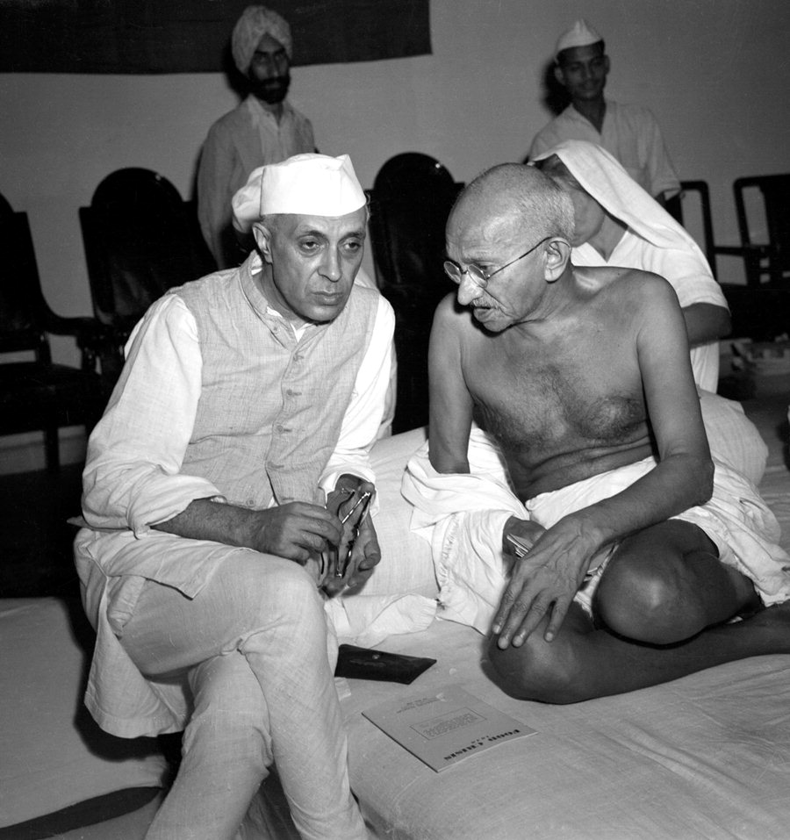
Gandhi’s Good Friend was Jawaharlal Nehru (First Prime Minister of India)

Slide 7
What children can learn from Gandhi
Truth or Satya
“The story of My experiments with Truth”
Non Violence or Ahimsa
“ An eye for an eye makes the whole world blind”
Faith
- Gandhi practiced Hinduism and believed all faiths to be equal
Simplicity
- Spun his own clothes and wore dhoti

Slide 8

Gandhi’s 3 monkeys
See no Evil
Hear no Evil
Say no Evil

Slide 9
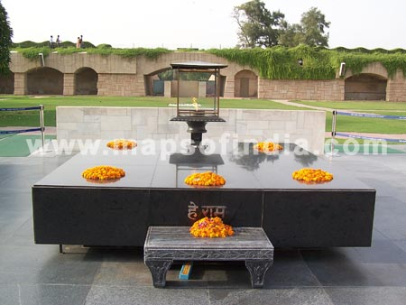
Gandhi’s memorial in Delhi - Rajghat

Slide 10
Inspiring Stories from Gandhi’s Life -1
The night was very dark and Mohan was frightened. He had always been afraid of ghosts. Whenever he was alone in the dark, he was afraid that a ghost lurking in some dark corner would suddenly spring on him. And tonight it was so dark that one could barely see one's own hand. Mohan had to go from one room to another.
As he stepped out of the room, his feet seemed to turn to lead and his heart began to beat like a drum. Rambha, their old maidservant was standing by the door.
"What's the matter, son?" she asked with a laugh.
"I am frightened, Dai," Mohan answered.
" Frightened, child! Frightened of what?"
"See how dark it is! I'm afraid of ghosts!" Mohan whispered in a terrified voice.
Rambha patted his head affectionately and said, "Whoever heard of anyone being afraid of dark! Listen to me: Think of Rama and no ghost will dare come near you. No one will touch a hair of your head. Rama will protect you."
Rambha's words gave Mohan courage. Repeating the name of Rama, he left the room. And from that day, Mohan was never lonely or afraid. He believed that as long as Rama was with him, he was safe from the danger.
This faith gave Gandhiji strength throughout his life, and even when he died the name of Rama was on his lips.

Slide 11
Inspiring Stories from Gandhi’s Life -2
Mohan was very shy. As soon as the school bell rang, he collected his books and hurried home. Other boys chatted and stopped on the way; some to play, others to eat, but Mohan always went straight home. He was afraid that the boys might stop him and make fun of him.
One day, the Inspector of Schools, Mr. Giles, came to Mohan's school. He read out five English words to the class and asked the boys to write them down. Mohan wrote four words correctly, but he could not spell the fifth word 'Kettle'. Seeing Mohan's hesitation, the teacher made a sign behind the Inspector's back that he should copy the word from his neighbour's slate. But Mohan ignored his signs. The other boys wrote all the five words correctly; Mohan wrote only four. After the Inspector left, the teacher scolded him. "I told you to copy from your neighbour," he said angrily. "Couldn't you even do that correctly?"Every one laughed.
As he went home that evening, Mohan was not unhappy. He knew he had done the right thing. What made him sad was that his teacher asked him to cheat.

